Slide 1
Queues
Chapter 7
Notes:
1

Slide 2
Chapter Contents
Introduction
Linear (Array) Queue Implementation
Linked Queue Implementation
Queue Implementation: Derived Class
Queue Applications

Slide 3
Objective
Learn how to implement a queue as a linked queue

Slide 4
Linked Implementation of Queues
Issues with array (linear) queue representation:
Fixed number of elements can be placed in a queue
Requires special array treatment with the values of the indices queueFront, queueRear
Linked implementation of a queue:
Use pointer variables to dynamically allocate, deallocate memory
Use linked list to dynamically organize data
Simplifies special cases of the array implementation
Queue never full

Slide 5
Value of queueFront
In linear representation:
Locates first item in the queue (gives index of the array)
Gives index of the element to be dequeued
In linked representation:
Points to the first element in the queue
Gives address (memory location) of the first element of the queue (location of element to be dequeued)

Slide 6
Value of queueRear
In linear representation:
Locates last item in the queue (gives index of the array)
Gives index of the element to be enqueued
In linked representation:
Points to the last element in the queue
Gives address (memory location) of the last element of the queue (location of element to be enqueued)

Slide 7
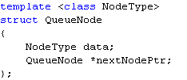
The QueueNode Structure
Each node in the linked queue is implemented as a template structure consisting of two fields:
data of a generic data type NodeType
nextNodePtr which is a pointer to the next queue node

Slide 8
The LinkedQueueType Class
LinkedQueueType <Type>
*queueFront : QueueNode
*queueRear: QueueNode
queueSize : int
LinkedQueueType( )
resetQueue( ) : void
isQueueEmpty ( ) : boolean
enqueue(Type ) : boolean
peekAtQueueFront(Type ) : boolean
peekAtQueueRear(Type ) : boolean
dequeue(Type ) : boolean
getQueueSize( integer ) : void
printQueue( ) : void
~LinkedQueueType()
createNewNode( Type) : QueueNode *

Slide 9
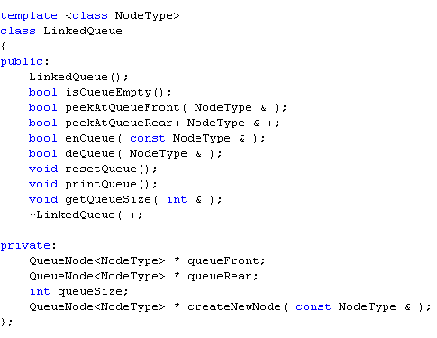
Implementing The LinkedQueue Class

Slide 10
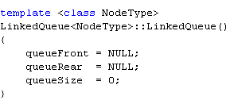
Implementing the Constructor
When queue object declared
Initializes queue to an empty state
Sets queueFront and queueRear to NULL
Sets queueSize to 0

Slide 11
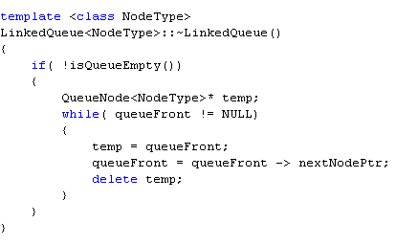
Implementing the Destructor
When the application ends, deallocate memory occupied by all queue nodes

Slide 12
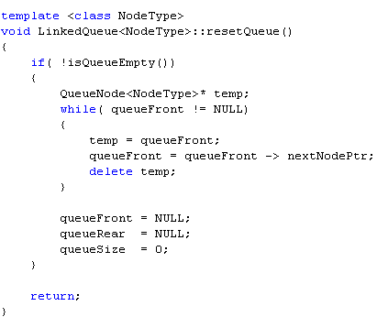
Reset Queue
Reinitializes queue to an empty state

Slide 13
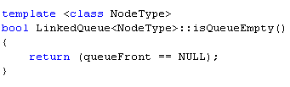
Empty Queue
Value of queueFront indicates if queue is empty
Queue is empty if queueFront is NULL
Queue is not empty otherwise

Slide 14
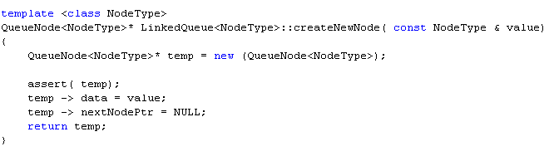
Utility Function: Create New Node
Called when a new queue node needs to be created
Function enqueue
Returns a dynamically allocated QueueNode object

Slide 15
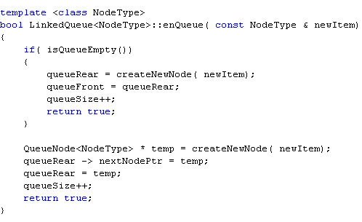
Enqueue
A newly created queue node is added at the end of the linked queue pointed to by queueRear
Value of pointer queueRear updated

Slide 16
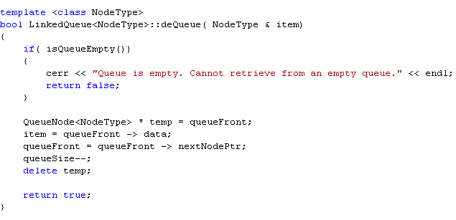
Dequeue
Removes first element in the queue
Node pointed to by queueFront removed
Value of pointer queueFront updated

Slide 17
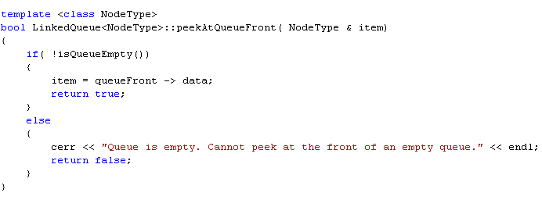
Peek at the Front of a Queue
Returns information of the node to which queueFront pointing

Slide 18
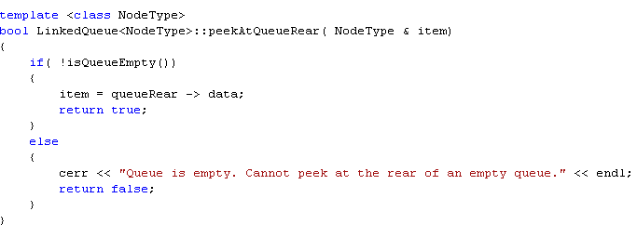
Peek at the Back of a Queue
Returns information of the node to which queueRear pointing

Slide 19
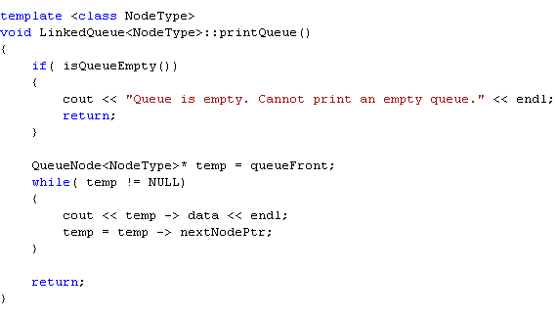
Print
Display contents of the queue

Slide 20
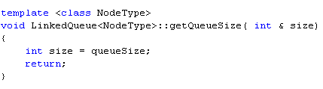
Utility Function: Queue Size

Slide 21
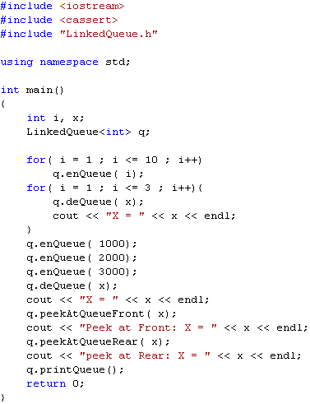
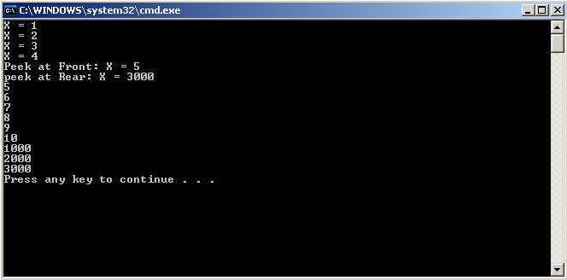
Testing the LinkedQueue Class

Slide 22
Section 3 - End

